Slide 1
Chapter 2
Instructions: Language of the Computer
Notes:
The University of Adelaide, School of Computer Science
Chapter 2 — Instructions: Language of the Computer

Slide 2
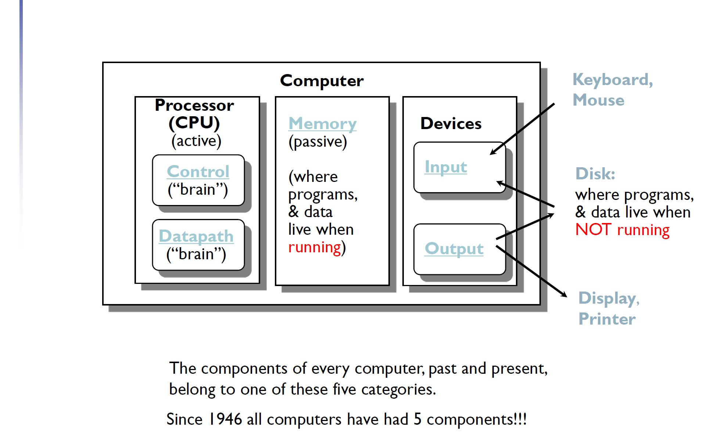
Machine Organization:
5 classic components of any computer
Chapter 2 — Instructions: Language of the Computer — <number>

Slide 3
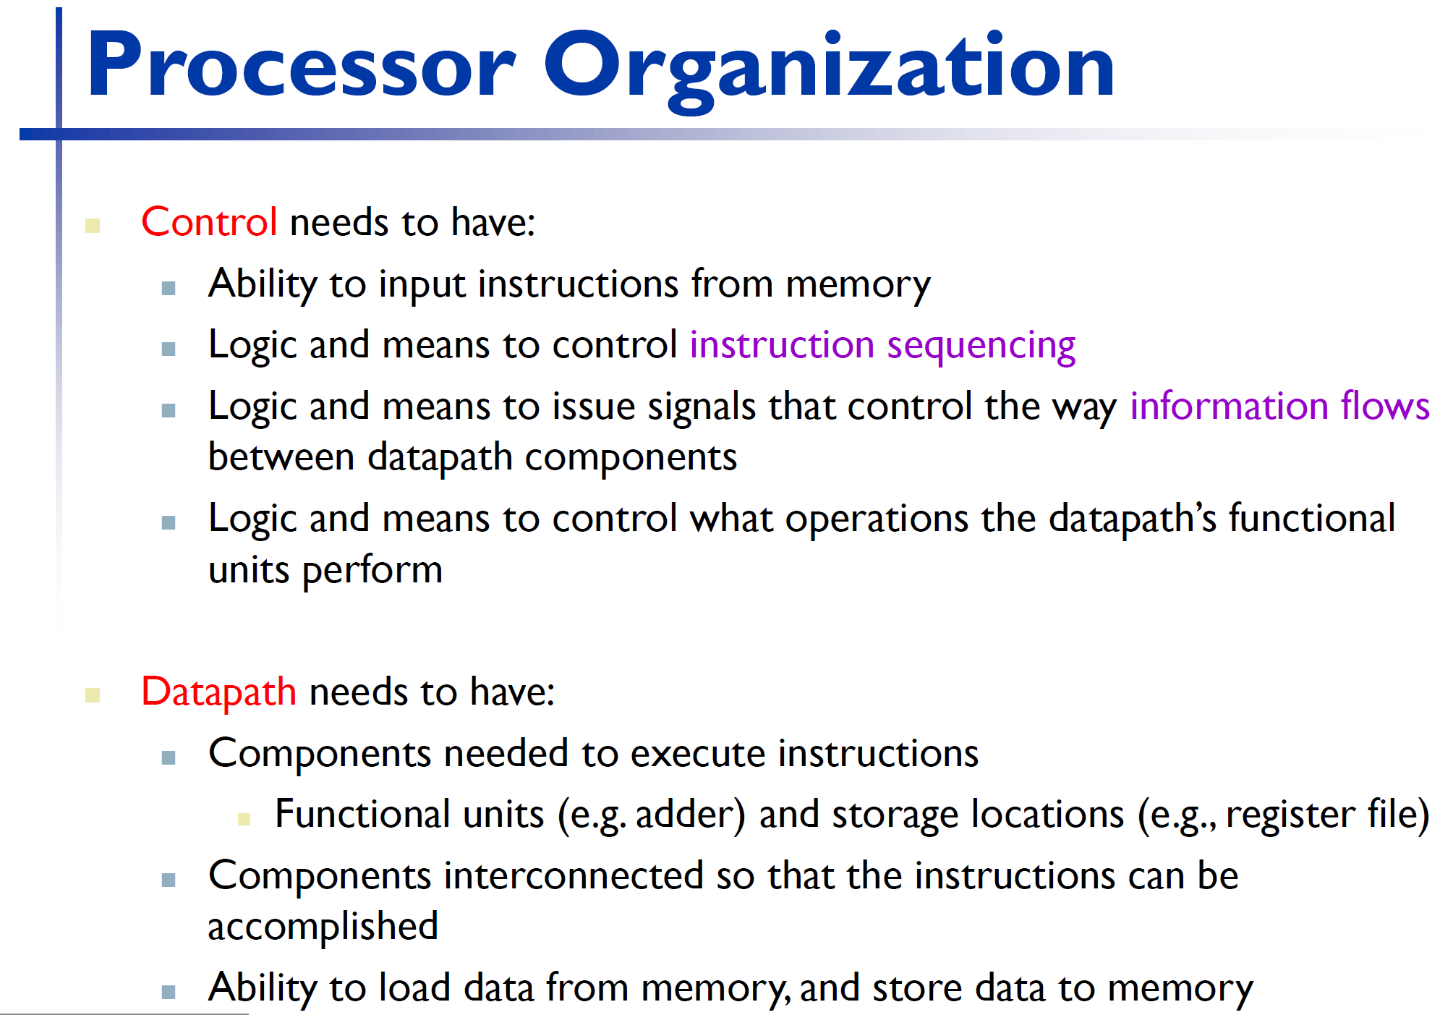
Chapter 2 — Instructions: Language of the Computer — <number>

Slide 4
Instruction Set
§2.1 Introduction
The repertoire of instructions of a computer
Different computers have different instruction sets
  But with many aspects in common
Early computers had very simple instruction sets
  Simplified implementation
Many modern computers also have simple instruction sets
Chapter 2 — Instructions: Language of the Computer — <number>
Notes:
The University of Adelaide, School of Computer Science
Chapter 2 — Instructions: Language of the Computer

Slide 5
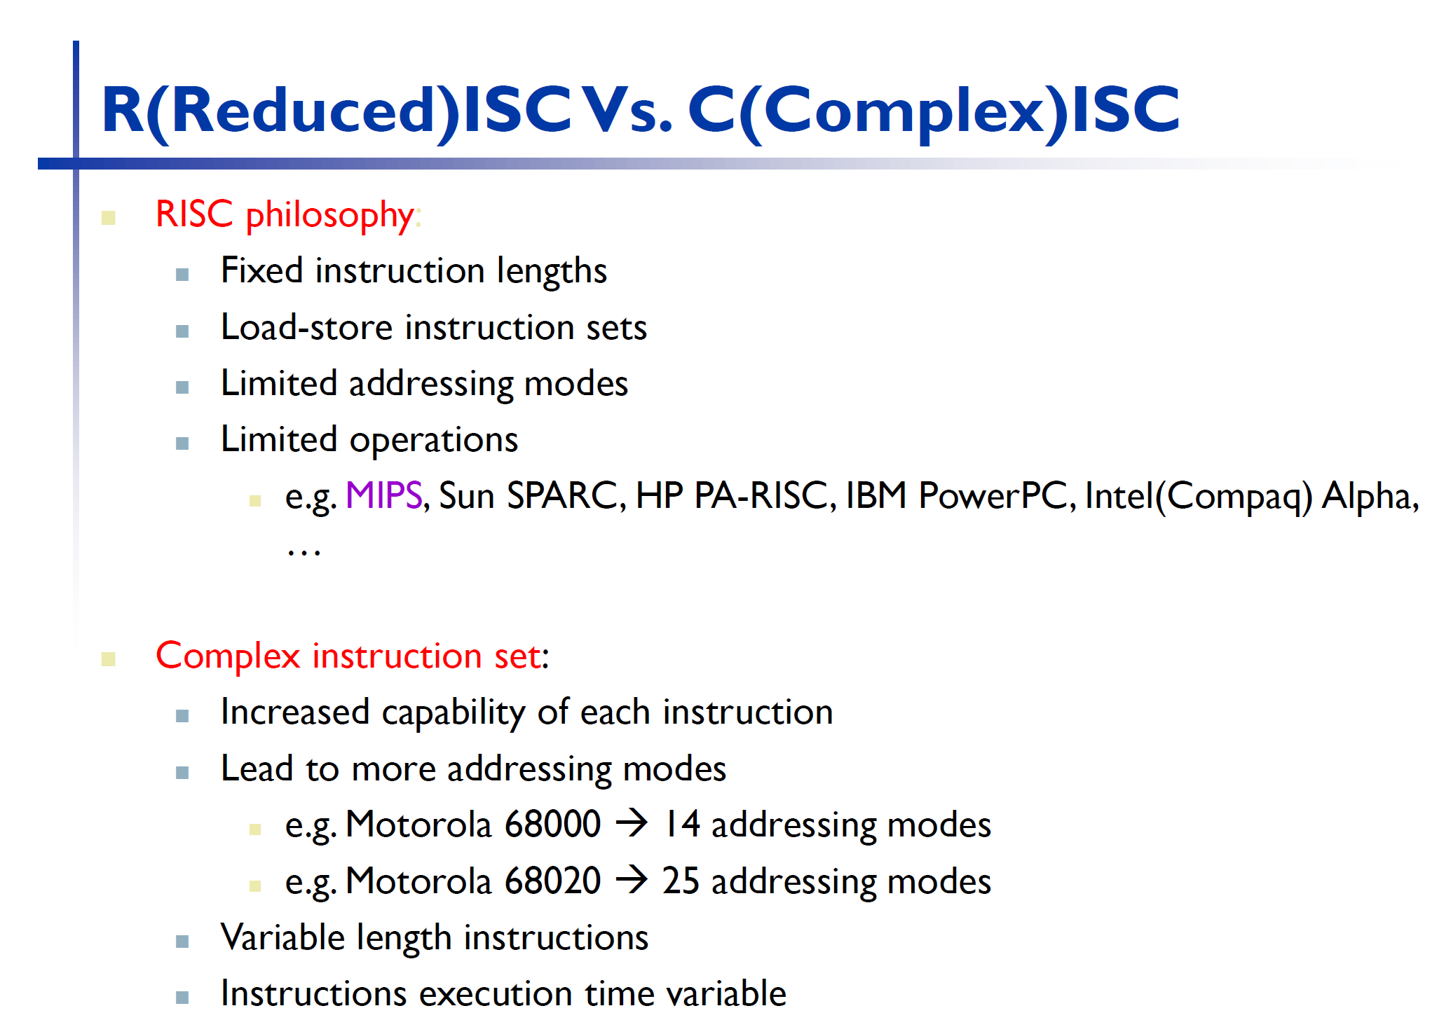
Chapter 2 — Instructions: Language of the Computer — <number>

Slide 6
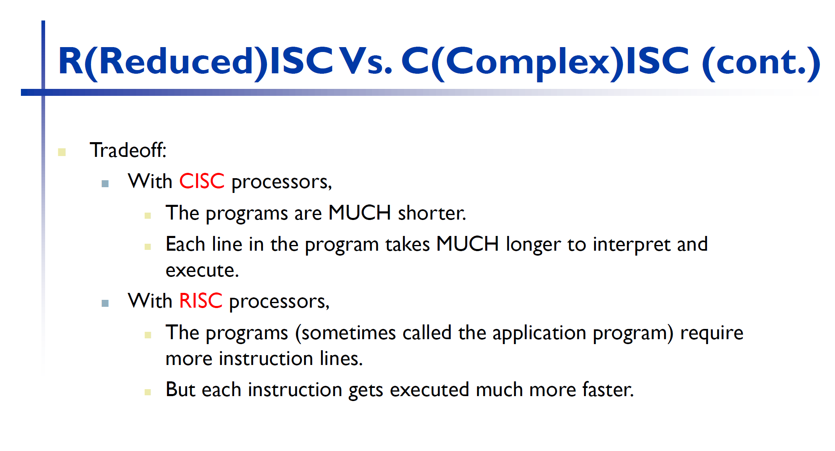
Chapter 2 — Instructions: Language of the Computer — <number>

Slide 7
The ARMv8 Instruction Set
A subset, called LEGv8, used as the example throughout the book
Commercialized by ARM Holdings (www.arm.com)
Large share of embedded core market
  Applications in consumer electronics, network/storage equipment, cameras, printers, …
Typical of many modern ISAs
  See ARM Reference Data tear-out card
Chapter 2 — Instructions: Language of the Computer — <number>
Notes:
The University of Adelaide, School of Computer Science
Chapter 2 — Instructions: Language of the Computer

Slide 8
Arithmetic Operations
Add and subtract, three operands
  Two sources and one destination
ADD a, b, c // a gets b + c
All arithmetic operations have this form
Design Principle 1: Simplicity favours regularity
  Regularity makes implementation simpler
  Simplicity enables higher performance at lower cost
§2.2 Operations of the Computer Hardware
Chapter 2 — Instructions: Language of the Computer — <number>
Notes:
The University of Adelaide, School of Computer Science
Chapter 2 — Instructions: Language of the Computer
The Regularity Principle – Regular rules, without exceptions, are easier to learn, use, describe, and implement.
Principles of Programming Languages – Bruce J. MacLennan

Slide 9
Arithmetic Example
C code:
f = (g + h) - (i + j);
Compiled LEGv8 code:
ADD t0, g, h // temp t0 = g + h
ADD t1, i, j // temp t1 = i + j
SUB f, t0, t1 // f = t0 - t1
Chapter 2 — Instructions: Language of the Computer — <number>
Notes:
The University of Adelaide, School of Computer Science
Chapter 2 — Instructions: Language of the Computer

Slide 10
Register Operands
Arithmetic instructions use register
operands
LEGv8 has a 32 × 64-bit register file
  Use for frequently accessed data
  64-bit data is called a “doubleword”
    31 x 64-bit general purpose registers X0 to X30
  32-bit data called a “word”
    31 x 32-bit general purpose sub-registers W0 to W30
Design Principle 2: Smaller is faster
  c.f. main memory: millions of locations
§2.3 Operands of the Computer Hardware
Chapter 2 — Instructions: Language of the Computer — <number>
Notes:
The University of Adelaide, School of Computer Science
Chapter 2 — Instructions: Language of the Computer

Slide 11
LEGv8 Registers
X0 – X7: procedure arguments/results
X8: indirect result location register
X9 – X15: temporaries
X16 – X17 (IP0 – IP1): may be used by linker as a scratch register, other times as temporary register
X18: platform register for platform independent code; otherwise a temporary register
X19 – X27: saved
X28 (SP): stack pointer
X29 (FP): frame pointer
X30 (LR): link register (return address)
XZR (register 31): the constant value 0
Chapter 2 — Instructions: Language of the Computer — <number>

Slide 12
Register Operand Example
C code:
f = (g + h) - (i + j);
  f, …, j in X19, X20, …, X23
Compiled LEGv8 code:
ADD X9, X20, X21
ADD X10, X22, X23
SUB X19, X9, X10
Chapter 2 — Instructions: Language of the Computer — <number>
Notes:
The University of Adelaide, School of Computer Science
Chapter 2 — Instructions: Language of the Computer

Slide 13
Memory Operands
Main memory used for composite data
  Arrays, structures, dynamic data
To apply arithmetic operations
  Load values from memory into registers
  Store result from register to memory
Memory is byte addressed
  Each address identifies an 8-bit byte
LEGv8 does not require words to be aligned in memory, except for instructions and the stack
Chapter 2 — Instructions: Language of the Computer — <number>
Notes:
The University of Adelaide, School of Computer Science
Chapter 2 — Instructions: Language of the Computer

Slide 14
Memory Operand Example
C code:
A[12] = h + A[8];
  h in X21, base address of A in X22
Compiled LEGv8 code:
  Index 8 requires offset of 64
LDUR X9,[X22,#64] // U for “unscaled”
ADD X9,X21,X9
STUR X9,[X22,#96]
Chapter 2 — Instructions: Language of the Computer — <number>
Notes:
The University of Adelaide, School of Computer Science
Chapter 2 — Instructions: Language of the Computer

Slide 15
Registers vs. Memory
Registers are faster to access than memory
Operating on memory data requires loads and stores
  More instructions to be executed
Compiler must use registers for variables as much as possible
  Only spill to memory for less frequently used variables
  Register optimization is important!
Chapter 2 — Instructions: Language of the Computer — <number>
Notes:
The University of Adelaide, School of Computer Science
Chapter 2 — Instructions: Language of the Computer
https://www.ifixit.com/Teardown/Google+Pixel+3a+Teardown/123256 – Look at this page and discuss locations Talk about cache memory at a high level.
Now show int a, b, c; and then convert to register int a, b, c;

Slide 16
Immediate Operands
Constant data specified in an instruction
ADDI X22, X22, #4
Design Principle 3: Make the common case fast
  Small constants are common
  Immediate operand avoids a load instruction
Chapter 2 — Instructions: Language of the Computer — <number>
Notes:
The University of Adelaide, School of Computer Science
Chapter 2 — Instructions: Language of the Computer

Slide 17
Unsigned Binary Integers
Given an n-bit number
§2.4 Signed and Unsigned Numbers
Range: 0 to +2^{n} – 1
Example
  0000 0000 0000 0000 0000 0000 0000 1011₂
  = 0 + … + 1×2³ + 0×2² +1×2¹ +1×2⁰
  = 0 + … + 8 + 0 + 2 + 1 = 11₁₀
Using 32 bits
  0 to +4,294,967,295
Chapter 2 — Instructions: Language of the Computer — <number>
Notes:
The University of Adelaide, School of Computer Science
Chapter 2 — Instructions: Language of the Computer

Slide 18
2s-Complement Signed Integers
Given an n-bit number
Range: –2^{n – 1} to +2^{n – 1} – 1
Example
  1111 1111 1111 1111 1111 1111 1111 1100₂
  = –1×2³¹ + 1×2³⁰ + … + 1×2² +0×2¹ +0×2⁰
  = –2,147,483,648 + 2,147,483,644 = –4₁₀
Using 32 bits
  –2,147,483,648 to +2,147,483,647
Chapter 2 — Instructions: Language of the Computer — <number>
Notes:
The University of Adelaide, School of Computer Science
Chapter 2 — Instructions: Language of the Computer

Slide 19
2s-Complement Signed Integers
Bit 31 is sign bit
  1 for negative numbers
  0 for non-negative numbers
–(–2^{n – 1}) can’t be represented
Non-negative numbers have the same unsigned and 2s-complement representation
Some specific numbers
  0: 0000 0000 … 0000
  –1: 1111 1111 … 1111
  Most-negative: 1000 0000 … 0000
  Most-positive: 0111 1111 … 1111
Chapter 2 — Instructions: Language of the Computer — <number>
Notes:
The University of Adelaide, School of Computer Science
Chapter 2 — Instructions: Language of the Computer

Slide 20

Signed Negation
Complement and add 1
  Complement means 1 → 0, 0 → 1
Example: negate +2
  +2 = 0000 0000 … 0010_{two}
  –2 = 1111 1111 … 1101_{two} + 1
  = 1111 1111 … 1110_{two}
Chapter 2 — Instructions: Language of the Computer — <number>
Notes:
The University of Adelaide, School of Computer Science
Chapter 2 — Instructions: Language of the Computer

Slide 21
Sign Extension
Representing a number using more bits
  Preserve the numeric value
Replicate the sign bit to the left
  c.f. unsigned values: extend with 0s
Examples: 8-bit to 16-bit
  +2: 0000 0010 => 0000 0000 0000 0010
  –2: 1111 1110 => 1111 1111 1111 1110
In LEGv8 instruction set
  LDURSB: sign-extend loaded byte
  LDURB: zero-extend loaded byte
Chapter 2 — Instructions: Language of the Computer — <number>
Notes:
The University of Adelaide, School of Computer Science
Chapter 2 — Instructions: Language of the Computer

Slide 22
Representing Instructions
Instructions are encoded in binary
  Called machine code
LEGv8 instructions
  Encoded as 32-bit instruction words
  Small number of formats encoding operation code (opcode), register numbers, …
  Regularity!
§2.5 Representing Instructions in the Computer
Chapter 2 — Instructions: Language of the Computer — <number>
Notes:
The University of Adelaide, School of Computer Science
Chapter 2 — Instructions: Language of the Computer

Slide 23
Hexadecimal
Base 16
  Compact representation of bit strings
  4 bits per hex digit
0 | 0000 | 4 | 0100 | 8 | 1000 | c | 1100
1 | 0001 | 5 | 0101 | 9 | 1001 | d | 1101
2 | 0010 | 6 | 0110 | a | 1010 | e | 1110
3 | 0011 | 7 | 0111 | b | 1011 | f | 1111
Example: eca8 6420
  1110 1100 1010 1000 0110 0100 0010 0000
Chapter 2 — Instructions: Language of the Computer — <number>
Notes:
The University of Adelaide, School of Computer Science
Chapter 2 — Instructions: Language of the Computer

Slide 24
LEGv8 R-format Instructions
opcode
Rm
shamt
Rn
Rd
11 bits
5 bits
6 bits
5 bits
5 bits
Instruction fields
  opcode: operation code
  Rm: the second register source operand
  shamt: shift amount (00000 for now)
  Rn: the first register source operand
  Rd: the register destination
Chapter 2 — Instructions: Language of the Computer — <number>
Notes:
The University of Adelaide, School of Computer Science
Chapter 2 — Instructions: Language of the Computer

Slide 25
R-format Example
opcode
Rm
shamt
Rn
Rd
11 bits
5 bits
6 bits
5 bits
5 bits
ADD X9,X20,X21
1112_{ten}
21_{ten}
0_{ten}
20_{ten}
9_{ten}
10001011000_{two}
10101_{two}
000000_{two}
10100_{two}
01001_{two}
1000 1011 0001 0101 0000 0010 1000 1001_{two} =
8B150289₁₆
Chapter 2 — Instructions: Language of the Computer — <number>
Notes:
The University of Adelaide, School of Computer Science
Chapter 2 — Instructions: Language of the Computer

Slide 26
LEGv8 D-format Instructions
opcode
address
op2
Rn
Rt
11 bits
9 bits
2 bits
5 bits
5 bits
Load/store instructions
  Rn: base register
  address: constant offset from contents of base register (+/- 32 doublewords)
  Rt: destination (load) or source (store) register number
Design Principle 3: Good design demands good compromises
  Different formats complicate decoding, but allow 32-bit instructions uniformly
  Keep formats as similar as possible
Chapter 2 — Instructions: Language of the Computer — <number>
Notes:
The University of Adelaide, School of Computer Science
Chapter 2 — Instructions: Language of the Computer
Show how LDUR X9, [X22,#64] fills the fields: #64 goes into address field, X22 is Rn, and X9 is Rt

Slide 27
LEGv8 I-format Instructions
opcode
immediate
Rn
Rd
10 bits
12 bits
5 bits
5 bits
Immediate instructions
  Rn: source register
  Rd: destination register
Immediate field is zero-extended
Chapter 2 — Instructions: Language of the Computer — <number>
Notes:
The University of Adelaide, School of Computer Science
Chapter 2 — Instructions: Language of the Computer

Slide 28

Stored Program Computers
The BIG Picture
Instructions represented in binary, just like data
Instructions and data stored in memory
Programs can operate on programs
  e.g., compilers, linkers, …
Binary compatibility allows compiled programs to work on different computers
  Standardized ISAs
Chapter 2 — Instructions: Language of the Computer — <number>
Notes:
The University of Adelaide, School of Computer Science
Chapter 2 — Instructions: Language of the Computer

Slide 29
Logical Operations
Instructions for bitwise manipulation
§2.6 Logical Operations
Operation | C | Java | LEGv8
Shift left | << | << | LSL
Shift right | >> | >>> | LSR
Bit-by-bit AND | & | & | AND, ANDI
Bit-by-bit OR | | | | | OR, ORI
Bit-by-bit NOT | ~ | ~ | EOR, EORI
Useful for extracting and inserting groups of bits in a word
Chapter 2 — Instructions: Language of the Computer — <number>
Notes:
The University of Adelaide, School of Computer Science
Chapter 2 — Instructions: Language of the Computer
>> versus >>> in Java, the first is arithmetic shift right and preserves the sign. The second is logical shift and inserts a 0 on the left

Slide 30
Shift Operations
opcode
Rm
shamt
Rn
Rd
11 bits
5 bits
6 bits
5 bits
5 bits
shamt: how many positions to shift
Shift left logical
  Shift left and fill with 0 bits
  LSL by i bits multiplies by 2^{i}
Shift right logical
  Shift right and fill with 0 bits
  LSR by i bits divides by 2^{i} (unsigned only)
Chapter 2 — Instructions: Language of the Computer — <number>
Notes:
The University of Adelaide, School of Computer Science
Chapter 2 — Instructions: Language of the Computer

Slide 31
AND Operations
Useful to mask bits in a word
  Select some bits, clear others to 0
AND X9,X10,X11
X10
00000000 00000000 00000000 00000000 00000000 00000000 00001101 11000000
X11
00000000 00000000 00000000 00000000 00000000 00000000 00111100 00000000
X9
00000000 00000000 00000000 00000000 00000000 00000000 00001100 00000000
Chapter 2 — Instructions: Language of the Computer — <number>
Notes:
The University of Adelaide, School of Computer Science
Chapter 2 — Instructions: Language of the Computer

Slide 32
OR Operations
Useful to include bits in a word
  Set some bits to 1, leave others unchanged
OR X9,X10,X11
X10
00000000 00000000 00000000 00000000 00000000 00000000 00001101 11000000
X11
00000000 00000000 00000000 00000000 00000000 00000000 00111100 00000000
X9
00000000 00000000 00000000 00000000 00000000 00000000 00111101 11000000
Chapter 2 — Instructions: Language of the Computer — <number>
Notes:
The University of Adelaide, School of Computer Science
Chapter 2 — Instructions: Language of the Computer

Slide 33
EOR Operations
Differencing operation
  Set some bits to 1, leave others unchanged
EOR X9,X10,X12 // NOT operation
X10
00000000 00000000 00000000 00000000 00000000 00000000 00001101 11000000
X12
11111111 11111111 11111111 11111111 11111111 11111111 11111111 11111111
X9
11111111 11111111 11111111 11111111 11111111 11111111 11110010 00111111
Chapter 2 — Instructions: Language of the Computer — <number>
Notes:
The University of Adelaide, School of Computer Science
Chapter 2 — Instructions: Language of the Computer

Slide 34
Conditional Operations
Branch to a labeled instruction if a condition is true
  Otherwise, continue sequentially
CBZ register, L1
  if (register == 0) branch to instruction labeled L1;
CBNZ register, L1
  if (register != 0) branch to instruction labeled L1;
B L1
  branch unconditionally to instruction labeled L1;
§2.7 Instructions for Making Decisions
Chapter 2 — Instructions: Language of the Computer — <number>
Notes:
The University of Adelaide, School of Computer Science
Chapter 2 — Instructions: Language of the Computer

Slide 35

Compiling If Statements
C code:
if (i==j) f = g+h;
else f = g-h;
  f, g, … in X19, X20, …
Compiled LEGv8 code:
SUB X9,X22,X23
CBNZ X9,Else
ADD X19,X20,X21
B Exit
Else: SUB X19,X20,x21
Exit: …
Assembler calculates addresses
Chapter 2 — Instructions: Language of the Computer — <number>
Notes:
The University of Adelaide, School of Computer Science
Chapter 2 — Instructions: Language of the Computer

Slide 36
Compiling Loop Statements
C code:
while (save[i] == k) i += 1;
  i in x22, k in x24, address of save in x25
Compiled LEGv8 code:
Loop: LSL X10,X22,#3
ADD X10,X10,X25
LDUR X9,[X10,#0]
SUB X11,X9,X24
CBNZ X11,Exit
ADDI X22,X22,#1
B Loop
Exit: …
Chapter 2 — Instructions: Language of the Computer — <number>
Notes:
The University of Adelaide, School of Computer Science
Chapter 2 — Instructions: Language of the Computer

Slide 37
Basic Blocks
A basic block is a sequence of instructions with
  No embedded branches (except at end)
  No branch targets (except at beginning)
A compiler identifies basic blocks for optimization
An advanced processor can accelerate execution of basic blocks
Chapter 2 — Instructions: Language of the Computer — <number>
Notes:
The University of Adelaide, School of Computer Science
Chapter 2 — Instructions: Language of the Computer

Slide 38
More Conditional Operations
Condition codes, set from arithmetic instruction with S-suffix (ADDS, ADDIS, ANDS, ANDIS, SUBS, SUBIS)
  negative (N): result had 1 in MSB
  zero (Z): result was 0
  overlow (V): result overflowed
  carry (C): result had carryout from MSB
Use subtract to set flags, then conditionally branch:
  B.EQ
  B.NE
  B.LT (less than, signed), B.LO (less than, unsigned)
  B.LE (less than or equal, signed), B.LS (less than or equal, unsigned)
  B.GT (greater than, signed), B.HI (greater than, unsigned)
  B.GE (greater than or equal, signed),
  B.HS (greater than or equal, unsigned)
Chapter 2 — Instructions: Language of the Computer — <number>
Notes:
The University of Adelaide, School of Computer Science
Chapter 2 — Instructions: Language of the Computer

Slide 39
Conditional Example
if (a > b) a += 1;
  a in X22, b in X23
  SUBS X9,X22,X23 // use subtract to make comparison
  B.LTE Exit // conditional branch
  ADDI X22,X22,#1
  Exit:
Chapter 2 — Instructions: Language of the Computer — <number>

Slide 40
Signed vs. Unsigned
Signed comparison
Unsigned comparison
Example
  X22 = 1111 1111 1111 1111 1111 1111 1111 1111
  X23 = 0000 0000 0000 0000 0000 0000 0000 0001
  X22 < X23 # signed
    –1 < +1
  X22 > X23 # unsigned
    +4,294,967,295 > +1
Chapter 2 — Instructions: Language of the Computer — <number>
Notes:
The University of Adelaide, School of Computer Science
Chapter 2 — Instructions: Language of the Computer

Slide 41
Procedure Calling
Steps required
  Place parameters in registers X0 to X7
  Transfer control to procedure
  Acquire storage for procedure
  Perform procedure’s operations
  Place result in register for caller
  Return to place of call (address in X30)
§2.8 Supporting Procedures in Computer Hardware
Chapter 2 — Instructions: Language of the Computer — <number>
Notes:
The University of Adelaide, School of Computer Science
Chapter 2 — Instructions: Language of the Computer

Slide 42
Procedure Call Instructions
Procedure call: jump and link
BL ProcedureLabel
  Address of following instruction put in X30
  Jumps to target address
Procedure return: jump register
BR LR
  Copies LR to program counter
  Can also be used for computed jumps
    e.g., for case/switch statements
Chapter 2 — Instructions: Language of the Computer — <number>
Notes:
The University of Adelaide, School of Computer Science
Chapter 2 — Instructions: Language of the Computer

Slide 43
Leaf Procedure Example
C code:
long long int leaf_example (long long int g, long long int h, long long int i, long long int j)
{ long long int f;
f = (g + h) - (i + j);
return f;
}
  Arguments g, …, j in X0, …, X3
  f in X19 and g and h use X9 and X10 (hence, need to save these on stack since caller may have been using)
Chapter 2 — Instructions: Language of the Computer — <number>
Notes:
The University of Adelaide, School of Computer Science
Chapter 2 — Instructions: Language of the Computer
Example is on page 102 in text

Slide 44
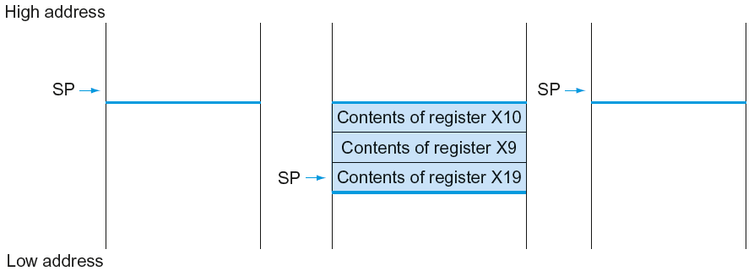
Local Data on the Stack
Chapter 2 — Instructions: Language of the Computer — <number>

Slide 45
Leaf Procedure Example
LEGv8 code:
leaf_example:
SUBI SP,SP,#24
STUR X10,[SP,#16]
STUR X9,[SP,#8]
STUR X19,[SP,#0]
ADD X9,X0,X1
ADD X10,X2,X3
SUB X19,X9,X10
ADD X0,X19,XZR
LDUR X10,[SP,#16]
LDUR X9,[SP,#8]
LDUR X19,[SP,#0]
ADDI SP,SP,#24
BR LR
Save X10, X9, X19 on stack
X9 = g + h
X10 = i + j
f = X9 – X10
copy f to return register
Resore X10, X9, X19 from stack
Return to caller
Chapter 2 — Instructions: Language of the Computer — <number>
Notes:
The University of Adelaide, School of Computer Science
Chapter 2 — Instructions: Language of the Computer
Notice the ADD instruction, it is the mov that we would use in the INTEL world. Add 0 and the save result into X0 is the same as move to X0

Slide 46
Register Usage
X9 to X17: temporary registers
  Not preserved by the callee
X19 to X28: saved registers
  If used, the callee saves and restores them
Chapter 2 — Instructions: Language of the Computer — <number>

Slide 47
Non-Leaf Procedures
Procedures that call other procedures
For nested call, caller needs to save on the stack:
  Its return address
  Any arguments and temporaries needed after the call
Restore from the stack after the call
Chapter 2 — Instructions: Language of the Computer — <number>
Notes:
The University of Adelaide, School of Computer Science
Chapter 2 — Instructions: Language of the Computer

Slide 48
Non-Leaf Procedure Example
C code:
long long int fact (long long int n)
{
if (n < 1) return 1;
else return n * fact(n - 1);
}
  Argument n in X0
  Result in X1
Chapter 2 — Instructions: Language of the Computer — <number>
Notes:
The University of Adelaide, School of Computer Science
Chapter 2 — Instructions: Language of the Computer

Slide 49
Leaf Procedure Example
LEGv8 code:
fact:
SUBI SP,SP,#16
STUR LR,[SP,#8]
STUR X0,[SP,#0]
SUBIS XZR,X0,#1
B.GE L1
ADDI X1,XZR,#1
ADDI SP,SP,#16
BR LR
L1: SUBI X0,X0,#1
BL fact
LDUR X0,[SP,#0]
LDUR LR,[SP,#8]
ADDI SP,SP,#16
MUL X1,X0,X1
BR LR
Save return address and n on stack
compare n and 1
if n >= 1, go to L1
Else, set return value to 1
Pop stack, don’t bother restoring values
Return
n = n - 1
call fact(n-1)
Restore caller’s n
Restore caller’s return address
Pop stack
return n * fact(n-1)
return
Chapter 2 — Instructions: Language of the Computer — <number>
Notes:
The University of Adelaide, School of Computer Science
Chapter 2 — Instructions: Language of the Computer

Slide 50
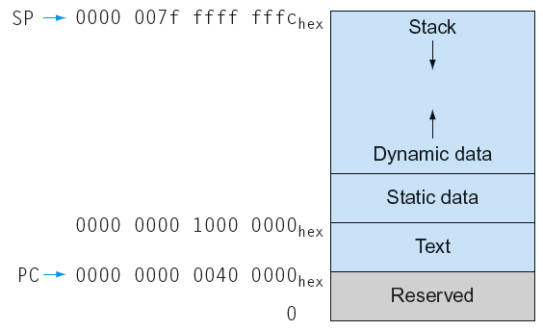
Memory Layout
Text: program code
Static data: global variables
  e.g., static variables in C, constant arrays and strings
Dynamic data: heap
  E.g., malloc in C, new in Java
Stack: automatic storage
Chapter 2 — Instructions: Language of the Computer — <number>
Notes:
The University of Adelaide, School of Computer Science
Chapter 2 — Instructions: Language of the Computer

Slide 51
Character Data
Byte-encoded character sets
  ASCII: 128 characters
    95 graphic, 33 control
  Latin-1: 256 characters
    ASCII, +96 more graphic characters
Unicode: 32-bit character set
  Used in Java, C++ wide characters, …
  Most of the world’s alphabets, plus symbols
  UTF-8, UTF-16: variable-length encodings
§2.9 Communicating with People
Chapter 2 — Instructions: Language of the Computer — <number>
Notes:
The University of Adelaide, School of Computer Science
Chapter 2 — Instructions: Language of the Computer

Slide 52
Byte/Halfword Operations
LEGv8 byte/halfword load/store
  Load byte:
    LDURB Rt, [Rn, offset]
    Sign extend to 32 bits in rt
  Store byte:
    STURB Rt, [Rn, offset]
    Store just rightmost byte
  Load halfword:
    LDURH Rt, [Rn, offset]
    Sign extend to 32 bits in rt
  Store halfword:
    STURH Rt, [Rn, offset]
    Store just rightmost halfword
Chapter 2 — Instructions: Language of the Computer — <number>
Notes:
The University of Adelaide, School of Computer Science
Chapter 2 — Instructions: Language of the Computer

Slide 53
String Copy Example
C code:
  Null-terminated string
void strcpy (char x[], char y[])
{ size_t i;
i = 0;
while ((x[i]=y[i])!='\0')
i += 1;
}
Chapter 2 — Instructions: Language of the Computer — <number>
Notes:
The University of Adelaide, School of Computer Science
Chapter 2 — Instructions: Language of the Computer

Slide 54
String Copy Example
LEGv8 code:
strcpy:
SUBI SP,SP,8 // push X19
STUR X19,[SP,#0]
ADD X19,XZR,XZR // i=0
L1: ADD X10,X19,X1 // X10 = addr of y[i]
LDURB X11,[X10,#0] // X11 = y[i]
ADD X12,X19,X0 // X12 = addr of x[i]
STURB X11,[X12,#0] // x[i] = y[i]
CBZ X11,L2 // if y[i] == 0 then exit
ADDI X19,X19,#1 // i = i + 1
B L1 // next iteration of loop
L2: LDUR X19,[SP,#0] // restore saved $s0
ADDI SP,SP,8 // pop 1 item from stack
BR LR // and return
Chapter 2 — Instructions: Language of the Computer — <number>
Notes:
The University of Adelaide, School of Computer Science
Chapter 2 — Instructions: Language of the Computer

Slide 55
32-bit Constants
Most constants are small
  12-bit immediate is sufficient
For the occasional 32-bit constant
MOVZ: move wide with zeros
MOVK: move with with keep
Use with flexible second operand (shift)
§2.10 LEGv8 Addressing for 32-Bit Immediates and Addresses
MOVZ X9,255,LSL 16
0000 0000 0000 0000
0000 0000 0000 0000
0000 0000 1111 1111
0000 0000 0000 0000
MOVK X9,255,LSL 0
0000 0000 0000 0000
0000 0000 0000 0000
0000 0000 1111 1111
0000 0000 1111 1111
Chapter 2 — Instructions: Language of the Computer — <number>
Notes:
The University of Adelaide, School of Computer Science
Chapter 2 — Instructions: Language of the Computer
Look at example on page 116

Slide 56
Branch Addressing
B-type
  B 10000 // go to location 10000_{ten}
CB-type
  CBNZ X19, Exit // go to Exit if X19 != 0
Both addresses are PC-relative
  Address = PC + offset (from instruction)
5
10000_{ten}
6 bits
26 bits
181
Exit
19
8 bits
19 bits
5 bits
Chapter 2 — Instructions: Language of the Computer — <number>
Notes:
The University of Adelaide, School of Computer Science
Chapter 2 — Instructions: Language of the Computer
Look at example on page 119, take time to explain 3 and -6 offsets (3 * 8 = 24 bytes forward and -6 * 8 = 48 back)

Slide 57
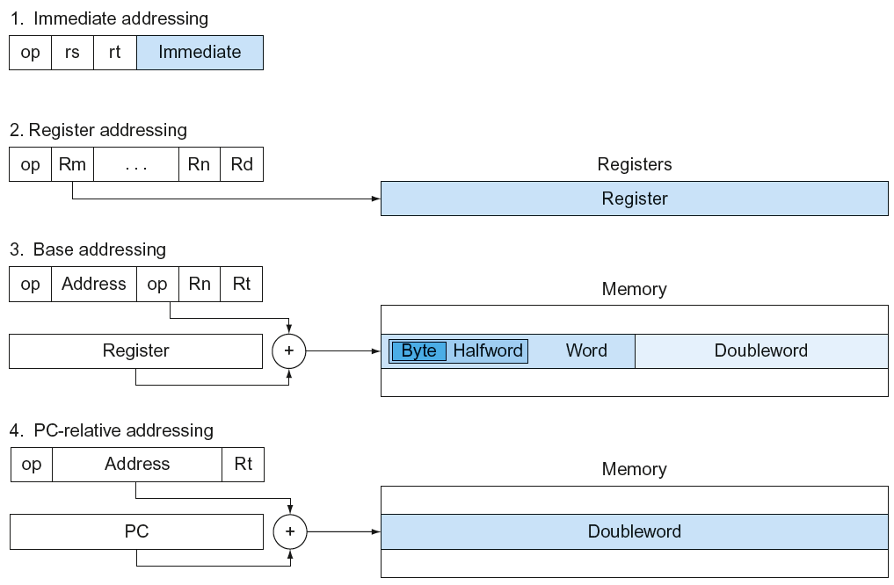
LEGv8 Addressing Summary
Chapter 2 — Instructions: Language of the Computer — <number>

Slide 58
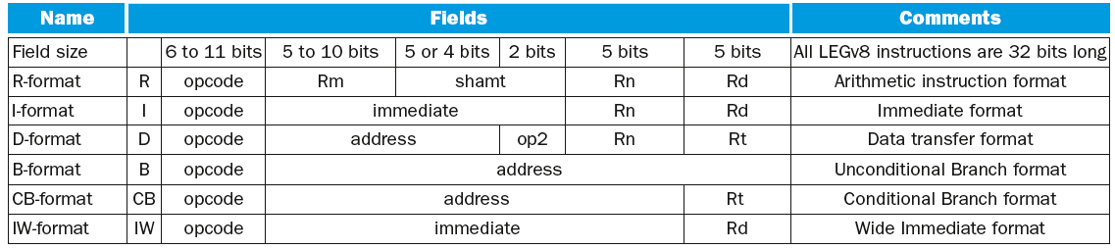
LEGv8 Encoding Summary
Chapter 2 — Instructions: Language of the Computer — <number>
Notes:
Talk about page 122 and 123
The University of Adelaide, School of Computer Science
Chapter 2 — Instructions: Language of the Computer

Slide 59
Synchronization
Two processors sharing an area of memory
  P1 writes, then P2 reads
  Data race if P1 and P2 don’t synchronize
    Result depends of order of accesses
Hardware support required
  Atomic read/write memory operation
  No other access to the location allowed between the read and write
Could be a single instruction
  E.g., atomic swap of register ↔ memory
  Or an atomic pair of instructions
§2.11 Parallelism and Instructions: Synchronization
Chapter 2 — Instructions: Language of the Computer — <number>
Notes:
The University of Adelaide, School of Computer Science
Chapter 2 — Instructions: Language of the Computer

Slide 60
Synchronization in LEGv8
Load exclusive register: LDXR
Store exclusive register: STXR
To use:
  Execute LDXR then STXR with same address
  If there is an intervening change to the address, store fails (communicated with additional output register)
  Only use register instruction in between
Chapter 2 — Instructions: Language of the Computer — <number>
Notes:
The University of Adelaide, School of Computer Science
Chapter 2 — Instructions: Language of the Computer

Slide 61
Synchronization in LEGv8
Example 1: atomic swap (to test/set lock variable)
  again: LDXR X10,[X20,#0]
  STXR X23,X9,[X20] // X9 = status
  CBNZ X9, again
  ADD X23,XZR,X10 // X23 = loaded value
Example 2: lock
  ADDI X11,XZR,#1 // copy locked value
  again: LDXR X10,[X20,#0] // read lock
  CBNZ X10, again // check if it is 0 yet
  STXR X11, X9, [X20] // attempt to store
  BNEZ X9,again // branch if fails
  Unlock:
  STUR XZR, [X20,#0] // free lock
Chapter 2 — Instructions: Language of the Computer — <number>

Slide 62
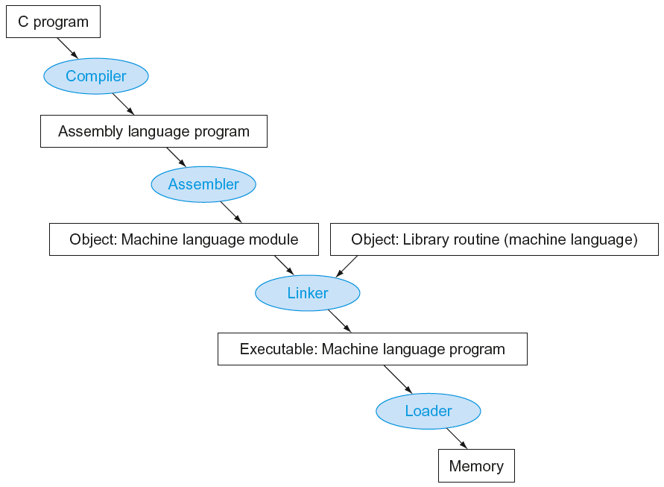
Translation and Startup
Many compilers produce object modules directly
§2.12 Translating and Starting a Program
Static linking
Chapter 2 — Instructions: Language of the Computer — <number>
Notes:
The University of Adelaide, School of Computer Science
Chapter 2 — Instructions: Language of the Computer

Slide 63
Producing an Object Module
Assembler (or compiler) translates program into machine instructions
Provides information for building a complete program from the pieces
  Header: described contents of object module
  Text segment: translated instructions
  Static data segment: data allocated for the life of the program
  Relocation info: for contents that depend on absolute location of loaded program
  Symbol table: global definitions and external refs
  Debug info: for associating with source code
Chapter 2 — Instructions: Language of the Computer — <number>
Notes:
The University of Adelaide, School of Computer Science
Chapter 2 — Instructions: Language of the Computer
Look at page 129 and discuss MOV converted to ORR and CMP converted to SUBS. MOV and CMP do not exist in ARM, but we can uses them as the assembler will convert to ORR and SUBS

Slide 64
Linking Object Modules
Produces an executable image
  1. Merges segments
  2. Resolve labels (determine their addresses)
  3. Patch location-dependent and external refs
Could leave location dependencies for fixing by a relocating loader
  But with virtual memory, no need to do this
  Program can be loaded into absolute location in virtual memory space
Chapter 2 — Instructions: Language of the Computer — <number>
Notes:
The University of Adelaide, School of Computer Science
Chapter 2 — Instructions: Language of the Computer

Slide 65
Loading a Program
Load from image file on disk into memory
  1. Read header to determine segment sizes
  2. Create virtual address space
  3. Copy text and initialized data into memory
    Or set page table entries so they can be faulted in
  4. Set up arguments on stack
  5. Initialize registers (including SP, FP)
  6. Jump to startup routine
    Copies arguments to X0, … and calls main
    When main returns, do exit syscall
Chapter 2 — Instructions: Language of the Computer — <number>
Notes:
The University of Adelaide, School of Computer Science
Chapter 2 — Instructions: Language of the Computer

Slide 66
Dynamic Linking
Only link/load library procedure when it is called
  Requires procedure code to be relocatable
  Avoids image bloat caused by static linking of all (transitively) referenced libraries
  Automatically picks up new library versions
Chapter 2 — Instructions: Language of the Computer — <number>
Notes:
The University of Adelaide, School of Computer Science
Chapter 2 — Instructions: Language of the Computer

Slide 67
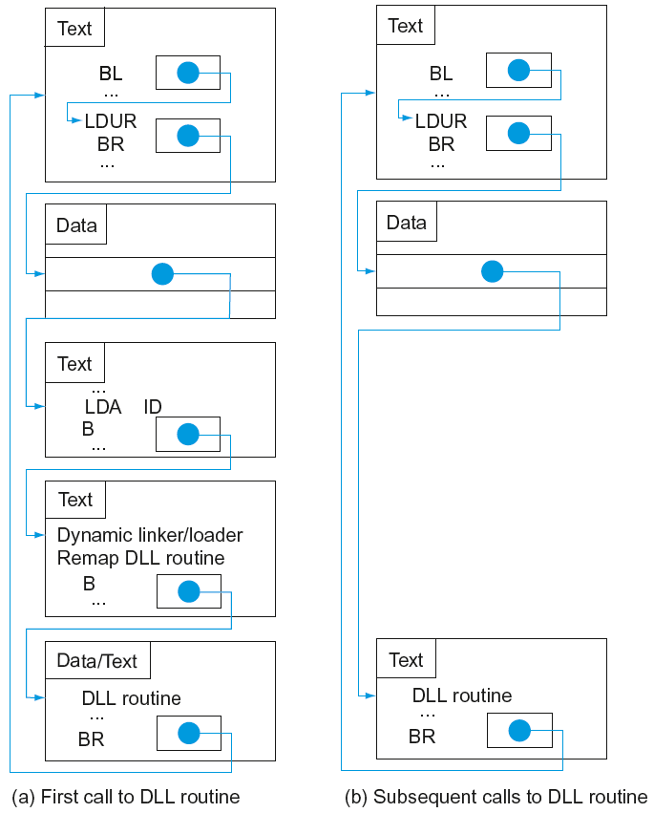
Lazy Linkage
Indirection table
Stub: Loads routine ID,
Jump to linker/loader
Linker/loader code
Dynamically
mapped code
Chapter 2 — Instructions: Language of the Computer — <number>
Notes:
The University of Adelaide, School of Computer Science
Chapter 2 — Instructions: Language of the Computer

Slide 68
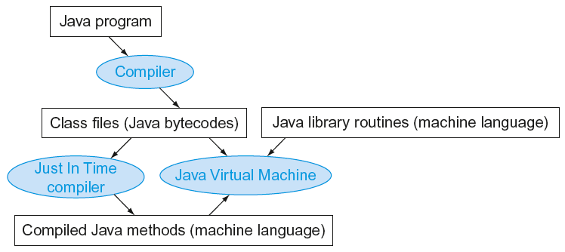
Starting Java Applications
Simple portable instruction set for the JVM
Compiles bytecodes of “hot” methods into native code for host machine
Interprets bytecodes
Chapter 2 — Instructions: Language of the Computer — <number>
Notes:
The University of Adelaide, School of Computer Science
Chapter 2 — Instructions: Language of the Computer

Slide 69
C Sort Example
Illustrates use of assembly instructions for a C bubble sort function
Swap procedure (leaf)
  void swap(long long int v[], long long int k)
  {
  long long int temp;
  temp = v[k];
  v[k] = v[k+1];
  v[k+1] = temp;
  }
  v in X0, k in X1, temp in X9
§2.13 A C Sort Example to Put It All Together
Chapter 2 — Instructions: Language of the Computer — <number>
Notes:
The University of Adelaide, School of Computer Science
Chapter 2 — Instructions: Language of the Computer

Slide 70
The Procedure Swap
swap: LSL X10,X1,#3 // X10 = k * 8
ADD X10,X0,X10 // X10 = address of v[k]
LDUR X9,[X10,#0] // X9 = v[k]
LDUR X11,[X10,#8] // X11 = v[k+1]
STUR X11,[X10,#0] // v[k] = X11 (v[k+1])
STUR X9,[X10,#8] // v[k+1] = X9 (v[k])
BR LR // return to calling routine
Chapter 2 — Instructions: Language of the Computer — <number>
Notes:
The University of Adelaide, School of Computer Science
Chapter 2 — Instructions: Language of the Computer

Slide 71
The Sort Procedure in C
Non-leaf (calls swap)
  void sort (long long int v[], size_t n)
  {
  size_t i, j;
  for (i = 0; i < n; i += 1) {
  for (j = i – 1;
  j >= 0 && v[j] > v[j + 1];
  j -= 1) {
  swap(v,j);
  }
  }
  }
  v in X0, n in X1, i in X19, j in X20
Chapter 2 — Instructions: Language of the Computer — <number>
Notes:
The University of Adelaide, School of Computer Science
Chapter 2 — Instructions: Language of the Computer
Figure 2.27 on page 140 has j+=1 and this is incorrect. HINT, think about j >= 0 when using size_t vs int

Slide 72
The Outer Loop
Skeleton of outer loop:
  for (i = 0; i <n; i += 1) {
MOV X19,XZR // i = 0
for1tst:
CMP X19, X1 // compare X19 to X1 (i to n)
B.GE exit1 // go to exit1 if X19 ≥ X1 (i≥n)
(body of outer for-loop)
ADDI X19,X19,#1 // i += 1
B for1tst // branch to test of outer loop
exit1:
Chapter 2 — Instructions: Language of the Computer — <number>
Notes:
The University of Adelaide, School of Computer Science
Chapter 2 — Instructions: Language of the Computer

Slide 73
The Inner Loop
Skeleton of inner loop:
  for (j = i − 1; j >= 0 && v[j] > v[j + 1]; j − = 1) {
SUBI X20, X19, #1 // j = i - 1
for2tst: CMP X20,XZR // compare X20 to 0 (j to 0)
B.LT exit2 // go to exit2 if X20 < 0 (j < 0)
LSL X10, X20, #3 // reg X10 = j * 8
ADD X11, X0, X10 // reg X11 = v + (j * 8)
LDUR X12, [X11,#0] // reg X12 = v[j]
LDUR X13, [X11,#8] // reg X13 = v[j + 1]
CMP X12, X13 // compare X12 to X13
B.LE exit2 // go to exit2 if X12 ≤ X13
MOV X0, X21 // first swap parameter is v
MOV X1, X20 // second swap parameter is j
BL swap // call swap
SUBI X20, X20, #1 // j –= 1
B for2tst // branch to test of inner loop
exit2:
Chapter 2 — Instructions: Language of the Computer — <number>
Notes:
The University of Adelaide, School of Computer Science
Chapter 2 — Instructions: Language of the Computer

Slide 74
Preserving Registers
Preserve saved registers:
SUBI SP,SP,#40 // make room on stack for 5 regs
STUR LR,[SP,#32] // save LR on stack
STUR X22,[SP,#24] // save X22 on stack
STUR X21,[SP,#16] // save X21 on stack
STUR X20,[SP,#8] // save X20 on stack
STUR X19,[SP,#0] // save X19 on stack
MOV X21, X0 // copy parameter X0 into X21
MOV X22, X1 // copy parameter X1 into X22
Restore saved registers:
exit1: LDUR X19, [SP,#0] // restore X19 from stack
LDUR X20, [SP,#8] // restore X20 from stack
LDUR X21,[SP,#16] // restore X21 from stack
LDUR X22,[SP,#24] // restore X22 from stack
LDUR X30,[SP,#32] // restore LR from stack
SUBI SP,SP,#40 // restore stack pointer
Chapter 2 — Instructions: Language of the Computer — <number>
Notes:
The University of Adelaide, School of Computer Science
Chapter 2 — Instructions: Language of the Computer
See final code on page 144 Figure 2.28

Slide 75




Effect of Compiler Optimization
Compiled with gcc for Pentium 4 under Linux
Chapter 2 — Instructions: Language of the Computer — <number>
Notes:
The University of Adelaide, School of Computer Science
Chapter 2 — Instructions: Language of the Computer

Slide 76



Effect of Language and Algorithm
Chapter 2 — Instructions: Language of the Computer — <number>
Notes:
The University of Adelaide, School of Computer Science
Chapter 2 — Instructions: Language of the Computer

Slide 77
Lessons Learnt
Instruction count and CPI are not good performance indicators in isolation
Compiler optimizations are sensitive to the algorithm
Java/JIT compiled code is significantly faster than JVM interpreted
  Comparable to optimized C in some cases
Nothing can fix a dumb algorithm!
Chapter 2 — Instructions: Language of the Computer — <number>
Notes:
The University of Adelaide, School of Computer Science
Chapter 2 — Instructions: Language of the Computer

Slide 78
Arrays vs. Pointers
Array indexing involves
  Multiplying index by element size
  Adding to array base address
Pointers correspond directly to memory addresses
  Can avoid indexing complexity
§2.14 Arrays versus Pointers
Chapter 2 — Instructions: Language of the Computer — <number>
Notes:
The University of Adelaide, School of Computer Science
Chapter 2 — Instructions: Language of the Computer

Slide 79
Example: Clearing an Array
clear1(int array[], int size) { int i; for (i = 0; i < size; i += 1) array[i] = 0; } | clear2(int *array, int size) { int *p; for (p = &array[0]; p < &array[size]; p = p + 1) *p = 0; }
MOV X9,XZR // i = 0 loop1: LSL X10,X9,#3 // X10 = i * 8 ADD X11,X0,X10 // X11 = address // of array[i] STUR XZR,[X11,#0] // array[i] = 0 ADDI X9,X9,#1 // i = i + 1 CMP X9,X1 // compare i to // size B.LT loop1 // if (i < size) // go to loop1 | MOV X9,X0 // p = address of // array[0] LSL X10,X1,#3 // X10 = size * 8 ADD X11,X0,X10 // X11 = address // of array[size] loop2: STUR XZR,0[X9,#0] // Memory[p] = 0 ADDI X9,X9,#8 // p = p + 8 CMP X9,X11 // compare p to < // &array[size] B.LT loop2 // if (p < // &array[size]) // go to loop2
Chapter 2 — Instructions: Language of the Computer — <number>
Notes:
The University of Adelaide, School of Computer Science
Chapter 2 — Instructions: Language of the Computer

Slide 80
Comparison of Array vs. Ptr
Multiply “strength reduced” to shift
Array version requires shift to be inside loop
  Part of index calculation for incremented i
  c.f. incrementing pointer
Compiler can achieve same effect as manual use of pointers
  Induction variable elimination
  Better to make program clearer and safer
Chapter 2 — Instructions: Language of the Computer — <number>
Notes:
The University of Adelaide, School of Computer Science
Chapter 2 — Instructions: Language of the Computer

Slide 81
ARM & MIPS Similarities
ARM: the most popular embedded core
Similar basic set of instructions to MIPS
§2.16 Real Stuff: ARM Instructions
 | ARM | MIPS
Date announced | 1985 | 1985
Instruction size | 32 bits | 32 bits
Address space | 32-bit flat | 32-bit flat
Data alignment | Aligned | Aligned
Data addressing modes | 9 | 3
Registers | 15 × 32-bit | 31 × 32-bit
Input/output | Memory mapped | Memory mapped
Chapter 2 — Instructions: Language of the Computer — <number>
Notes:
The University of Adelaide, School of Computer Science
Chapter 2 — Instructions: Language of the Computer

Slide 82
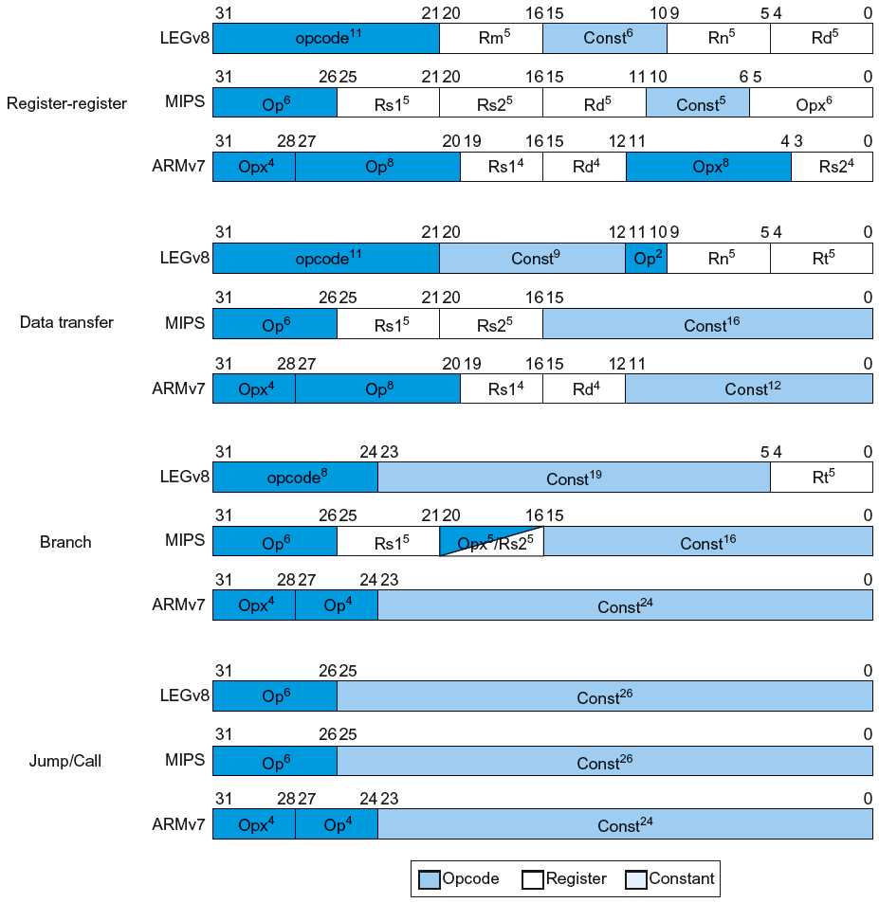
Instruction Encoding
Chapter 2 — Instructions: Language of the Computer — <number>
Notes:
The University of Adelaide, School of Computer Science
Chapter 2 — Instructions: Language of the Computer

Slide 83
The Intel x86 ISA
Evolution with backward compatibility
  8080 (1974): 8-bit microprocessor
    Accumulator, plus 3 index-register pairs
  8086 (1978): 16-bit extension to 8080
    Complex instruction set (CISC)
  8087 (1980): floating-point coprocessor
    Adds FP instructions and register stack
  80286 (1982): 24-bit addresses, MMU
    Segmented memory mapping and protection
  80386 (1985): 32-bit extension (now IA-32)
    Additional addressing modes and operations
    Paged memory mapping as well as segments
§2.17 Real Stuff: x86 Instructions
Chapter 2 — Instructions: Language of the Computer — <number>
Notes:
The University of Adelaide, School of Computer Science
Chapter 2 — Instructions: Language of the Computer

Slide 84
The Intel x86 ISA
Further evolution…
  i486 (1989): pipelined, on-chip caches and FPU
    Compatible competitors: AMD, Cyrix, …
  Pentium (1993): superscalar, 64-bit datapath
    Later versions added MMX (Multi-Media eXtension) instructions
    The infamous FDIV bug
  Pentium Pro (1995), Pentium II (1997)
    New microarchitecture (see Colwell, The Pentium Chronicles)
  Pentium III (1999)
    Added SSE (Streaming SIMD Extensions) and associated registers
  Pentium 4 (2001)
    New microarchitecture
    Added SSE2 instructions
Chapter 2 — Instructions: Language of the Computer — <number>
Notes:
The University of Adelaide, School of Computer Science
Chapter 2 — Instructions: Language of the Computer

Slide 85
The Intel x86 ISA
And further…
  AMD64 (2003): extended architecture to 64 bits
  EM64T – Extended Memory 64 Technology (2004)
    AMD64 adopted by Intel (with refinements)
    Added SSE3 instructions
  Intel Core (2006)
    Added SSE4 instructions, virtual machine support
  AMD64 (announced 2007): SSE5 instructions
    Intel declined to follow, instead…
  Advanced Vector Extension (announced 2008)
    Longer SSE registers, more instructions
If Intel didn’t extend with compatibility, its competitors would!
  Technical elegance ≠ market success
Chapter 2 — Instructions: Language of the Computer — <number>
Notes:
The University of Adelaide, School of Computer Science
Chapter 2 — Instructions: Language of the Computer

Slide 86

Basic x86 Registers
Chapter 2 — Instructions: Language of the Computer — <number>
Notes:
The University of Adelaide, School of Computer Science
Chapter 2 — Instructions: Language of the Computer

Slide 87
Basic x86 Addressing Modes
Two operands per instruction
Source/dest operand | Second source operand
Register | Register
Register | Immediate
Register | Memory
Memory | Register
Memory | Immediate
Memory addressing modes
  Address in register
  Address = R_{base} + displacement
  Address = R_{base} + 2^{scale} × R_{index} (scale = 0, 1, 2, or 3)
  Address = R_{base} + 2^{scale} × R_{index} + displacement
Chapter 2 — Instructions: Language of the Computer — <number>
Notes:
The University of Adelaide, School of Computer Science
Chapter 2 — Instructions: Language of the Computer

Slide 88
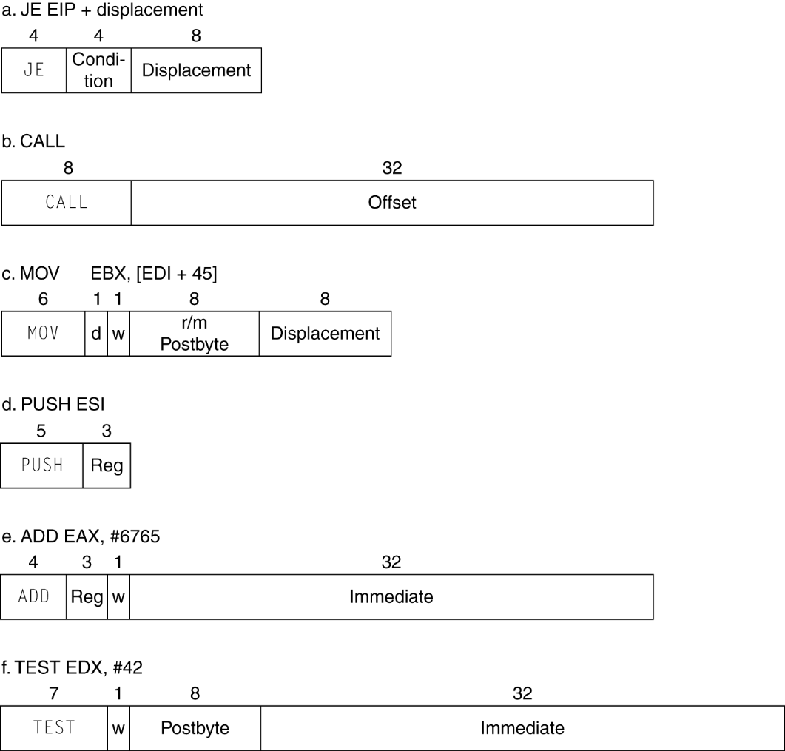
x86 Instruction Encoding
Variable length encoding
  Postfix bytes specify addressing mode
  Prefix bytes modify operation
    Operand length, repetition, locking, …
Chapter 2 — Instructions: Language of the Computer — <number>
Notes:
The University of Adelaide, School of Computer Science
Chapter 2 — Instructions: Language of the Computer

Slide 89
Implementing IA-32
Complex instruction set makes implementation difficult
  Hardware translates instructions to simpler microoperations
    Simple instructions: 1–1
    Complex instructions: 1–many
  Microengine similar to RISC
  Market share makes this economically viable
Comparable performance to RISC
  Compilers avoid complex instructions
Chapter 2 — Instructions: Language of the Computer — <number>
Notes:
The University of Adelaide, School of Computer Science
Chapter 2 — Instructions: Language of the Computer

Slide 90
Fallacies
Powerful instruction ⇒ higher performance
  Fewer instructions required
  But complex instructions are hard to implement
    May slow down all instructions, including simple ones
  Compilers are good at making fast code from simple instructions
Use assembly code for high performance
  But modern compilers are better at dealing with modern processors
  More lines of code ⇒ more errors and less productivity
§2.19 Fallacies and Pitfalls
Chapter 2 — Instructions: Language of the Computer — <number>
Notes:
The University of Adelaide, School of Computer Science
Chapter 2 — Instructions: Language of the Computer

Slide 91
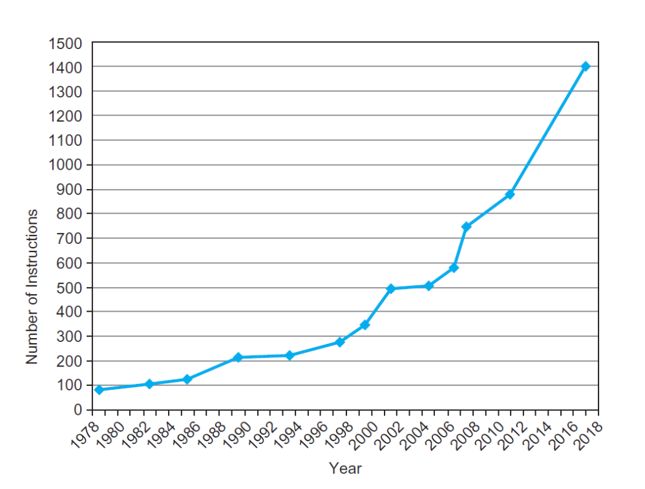
Fallacies
Backward compatibility ⇒ instruction set doesn’t change
  But they do accrete more instructions
x86 instruction set
Chapter 2 — Instructions: Language of the Computer — <number>`
Notes:
The University of Adelaide, School of Computer Science
Chapter 2 — Instructions: Language of the Computer

Slide 92
Pitfalls
Sequential words are not at sequential addresses
  Increment by 4, not by 1!
Keeping a pointer to an automatic variable after procedure returns
  e.g., passing pointer back via an argument
  Pointer becomes invalid when stack popped
Chapter 2 — Instructions: Language of the Computer — <number>
Notes:
The University of Adelaide, School of Computer Science
Chapter 2 — Instructions: Language of the Computer

Slide 93
Concluding Remarks
Design principles
  1. Simplicity favors regularity
  2. Smaller is faster
  3. Make the common case fast
  4. Good design demands good compromises
Layers of software/hardware
  Compiler, assembler, hardware
LEGv8: typical of RISC ISAs
  c.f. x86
§2.20 Concluding Remarks
Chapter 2 — Instructions: Language of the Computer — <number>
Notes:
The University of Adelaide, School of Computer Science
Chapter 2 — Instructions: Language of the Computer

Slide 94
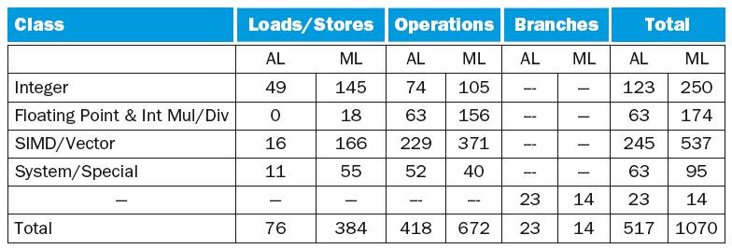
Concluding Remarks
Additional ARMv8 features:
  Flexible second operand
  Additional addressing modes
  Conditional instructions (e.g. CSET, CINC)
Chapter 2 — Instructions: Language of the Computer — <number>
Notes:
The University of Adelaide, School of Computer Science
Chapter 2 — Instructions: Language of the Computer

